Slide 1
स्वोच्छ
delta
4.0
Smart Garbage Management System
Team segFault
ACES TECHFEST 6.0 HACKATHON

Slide 2



WHAT ARE WE?
SAAS
We sell out software system to large scale governmental organizations to ease their responsibility for clean homeland using highly effective automation systems.
We provide this software to consumers to ease their responsibility of maintaining a healthy and clean environment.

Slide 3


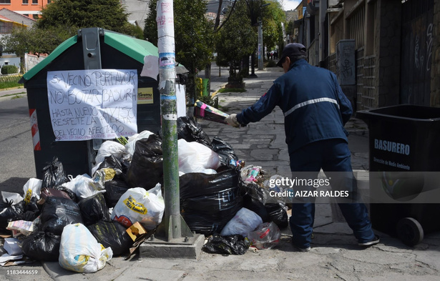
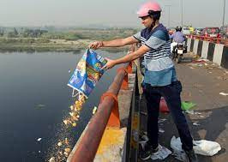
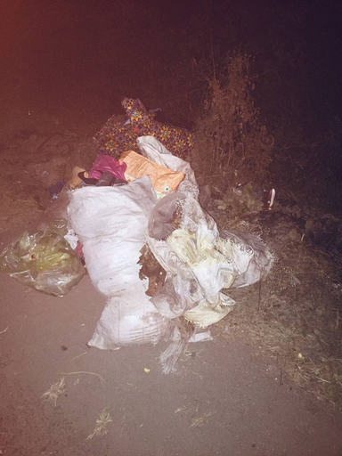
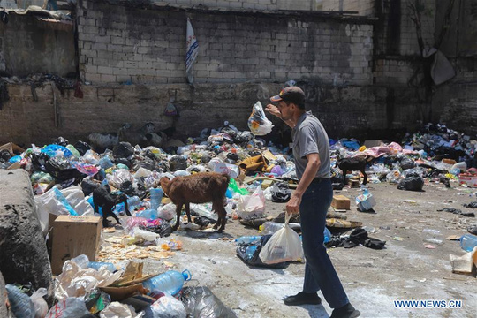
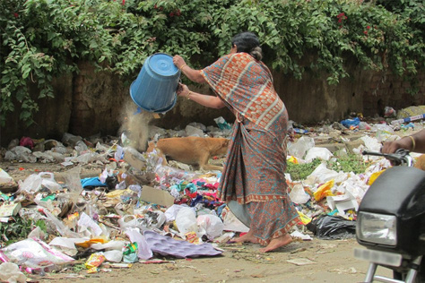
CURRENT
SITUATION
1
ROADSIDE
LITTERS
Most of the roadside is filled with the litters and dumps.
2
Waste collection times do not align with everyone's schedule, causing occasional missed pickups.
IRREGULAR GARBAGE PICKUP
3
People are unaware about different garbage class, their recycling and disposal methods.
POOR WASTE MANAGEMENT KNOWLEDGE

Slide 4



OUR GOALS
Pollution Reduction
Clean future
Seem less transition to recycling habits
Education and awareness

Slide 5



WHEN OUR BELOVED MAYOR SAID
“चाउचाउ खायो खोल भुँईमा फाल्यो, फ्यात्त फ्यात्त”
WE TOOK IT SERIOUSLY!

Slide 6


UNIQUE
FEATURES
01
Littering Detection using AI
02
Digitized Payment for service charges
Dynamic Waste collection with route optimizations
03
04
AI powered chatbot
Event notification and live route tracking using GPS
Waste category assistant (degradable/non)
05
06

Slide 7
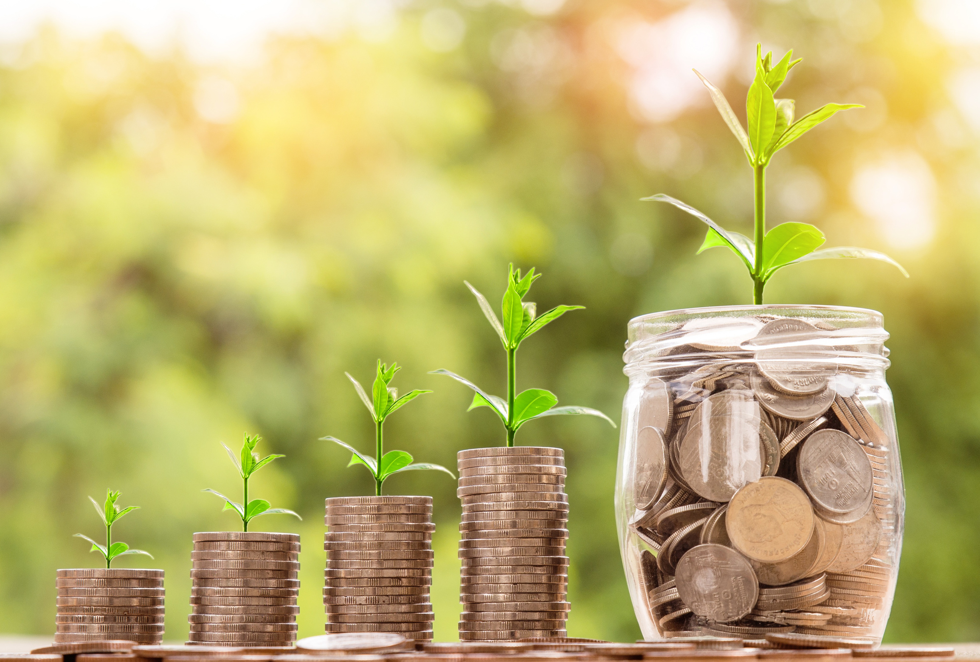



REVENUE MODELS
Software As a Service
Providing service to local government with subscription fee based on population size, service level, and platform features.
Data Analytics for Urban Planning
Offer advanced analytics services derived from the data collected by the system useful for local government for future city planning.
Relevant Ads
Publish relevant advertisements in client application.

Slide 8



FUTURE POSSIBILITIES
MORE INTERACTIVE CHATBOT WITH LOCAL LANGUAGE SUPPORT
ADD REAL TIME GARBAGE TRUCK’S CAPACITY
SMART WASTE BINS FOR AUTO COLLECTIONS
We plan to minimize work and maximize comfort for everyone.
SOCIAL CREDIT SYSTEM

Slide 9


TECHNICAL MODEL
Our system uses cutting edge technologies for the highest scalability and flexiblity.
WEB
NextJS
ML
YOLO/CNN
LANG
Typescript/Python
BOT
RASA

Slide 10

THANK YOU
Now onto the demo...

